Slide 1
National Research Symposium
for
Teachers and Heads of schools

Slide 2
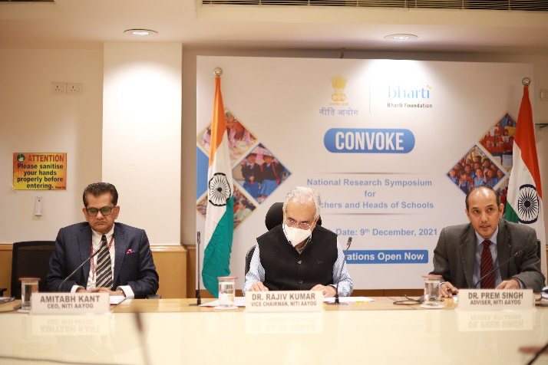
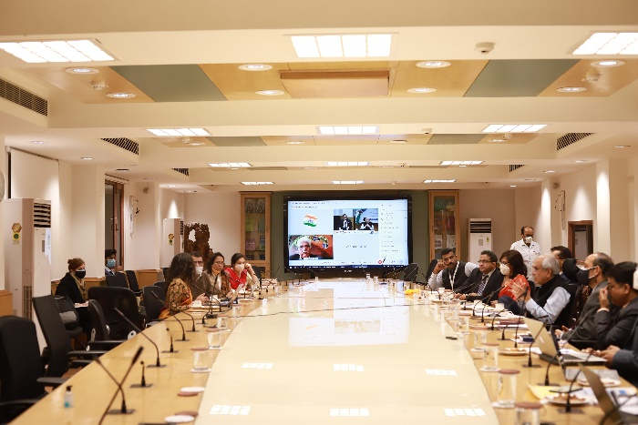
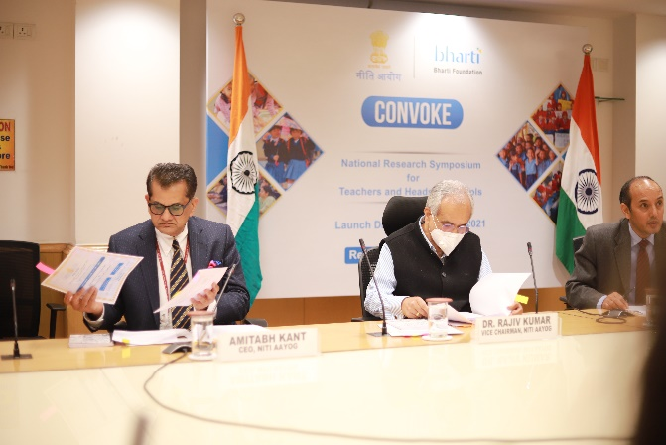
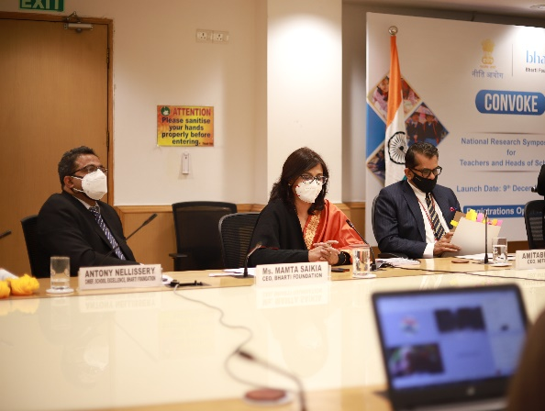
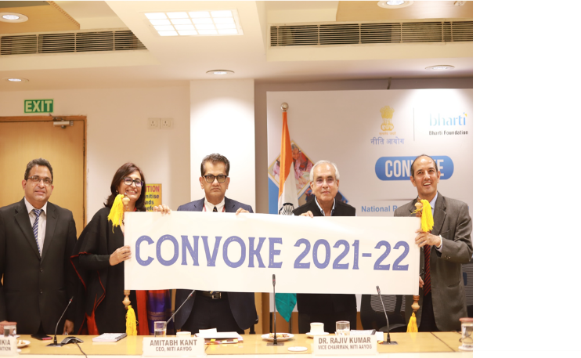
Convoke is a National Research Symposium for Teachers and Heads of schools
Use of research as a tool to enhance teachers’ capabilities
Evidence based pedagogy and decision making practices
This platform
Encourages:
To improve student learning outcomes in line with the National Education Policy 2020

Slide 3
Who can Participate?
Teachers and Head Teachers of
Government Schools and Satya Bharti Schools
Pre-Service Teacher Trainees of
DIETs/B.Ed/B.El.Ed programs

Slide 4
Language
Papers can be submitted in
all languages
recognized by the constitution of India

Slide 5
How to Register?
Please Register on: https://Bhartifoundation.org/convoke/
Once registered, send in the papers to the email id: convoke@bhartifoundation.org

Slide 6
Selection Criteria

Slide 7
Papers submitted in the format provided on the Bharti Foundation website and based on key findings will be shortlisted
Shortlisted presenters will be contacted and given feedback provided for updating the paper
All the selected papers will be reviewed by a jury
The Top 16 papers will be selected for National CONVOKE scheduled for February 2022

Slide 8
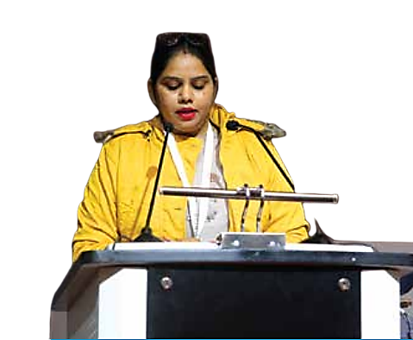
CONVOKE
National Symposium
Top 16 Papers

Slide 9
These top 16 presenters will be supported to make presentations at the National Research Symposium
The selected papers will be presented in four sessions during the event
Each of the sessions will have a moderator to collate the key findings and recommendations
We will also have key note speakers to address the topics

Slide 10
Top 3 papers will be awarded
In case of any query/question, you can contact Sameen Adeeb (9871108322)
OR
Email : convoke@bhartifoundation.org

Slide 11
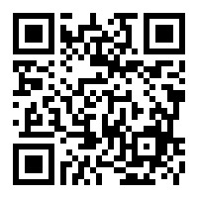
To submit your paper
Scan the QR Code

